Slide 1
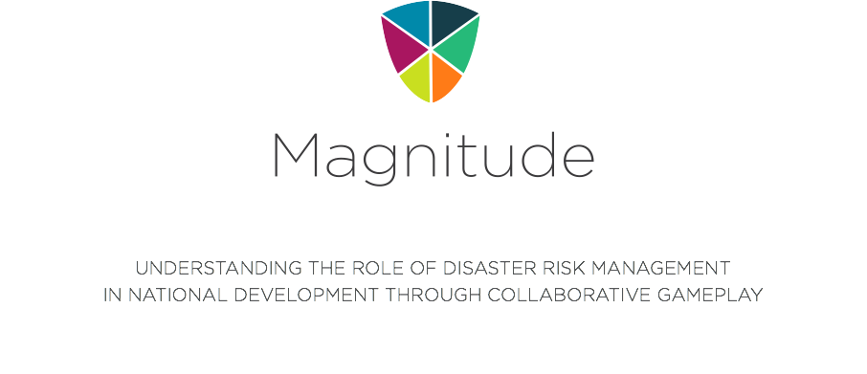
Notes:
If you have questions, you may find more information about the game at http://lienbtran.com/games/magnitude or you may contact Lien Tran at lien@lienbtran.com

Slide 2

Note to Conference Presenter:
This PowerPoint presentation deck was developed for large group conference settings. The game is played collaboratively in groups of four players.
Regular Scorecard should be used.
Disaster Cards (orange) are not used when using this presentation. Please put them aside.
Please refer to the PowerPoint presenter notes that contain additional rule and game information.

Slide 3

Global Assessment Report (GAR 2011)
http://www.preventionweb.net/english/hyogo/gar/2011/en/home/index.html
Notes:
Designed in 2010 to be launched with the 2011 GAR report

Slide 4


Slide 5
In 2011, over 130 governments are engaged in self-assessments of their progress towards the Hyogo Framework for Action (HFA), a 10-year plan to make the world safer from natural hazards. *
Magnitude highlights potential strategies to reduce disaster risk and to achieve the objective of the HFA, which is critical to the achievement of the U.N. Millennium Development Goals and to adapt to global climate change.
HFA is the first plan to explain, describe and detail the work that is required from all different sectors and actors to reduce disaster losses.
*

Slide 6
The Millennium Development Goals (MDGs) are the world's time-bound and quantified targets for addressing extreme poverty in its many dimensions-income poverty, hunger, disease, lack of adequate shelter, and exclusion-while promoting gender equality, education, and environmental sustainability.
These MDGs, along with related targets and measurable health and economic indicators, were identified by the U.N. at the Millennium Summit in September 2000.

Slide 7
Disaster Risk Reduction (DRR) aims to reduce the damage caused by natural hazards like earthquakes, floods, droughts and cyclones, through an ethic of prevention.
Disaster Risk Management (DRM) includes specific choices and measures that we can take to lower the impact of disasters on property and lives.

Slide 8
This game is an ampliﬁcation and simpliﬁcation of reality. The rules of the game and the mechanics of the game help model a complex system, and although they are based on facts, they should not be taken as fact. Please accept and do not challenge the rules as they define this system.
This game is a model of the choices and consequences government ministers face when trying to further their nation’s development.
Also games are always confusing in the beginning, and this game is no different. Magnitude will become very easy to play once we play 1-2 rounds.

Slide 9
It’s been 5 years since the 2000 launch of the U.N. Millennium Development Goals (MDGs). Your nation’s head of state realizes that your country is behind on the planning and progress towards these goals. She tasks you along with 3 other national ministers to implement a plan to maximize your nation’s achievements towards all 8 MDGs by the target year of 2015.
Your team of 4 needs to work together as you have a lot of work to do over the next 10 years. Good luck!

Slide 10
Object of the Game
To be the nation with the most points at the end of the game.
Points are determined by the number of MDG cards achieved at the end of the game. Your nation’s score is out of a maximum of 48 points and is an indicator of how well your nation is developed.

Slide 11
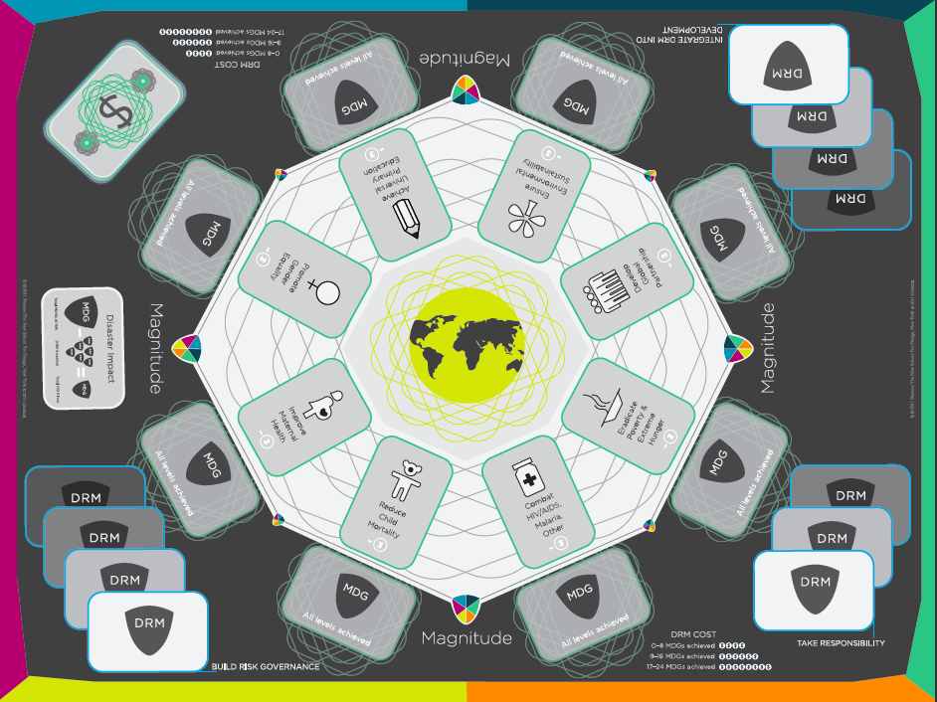
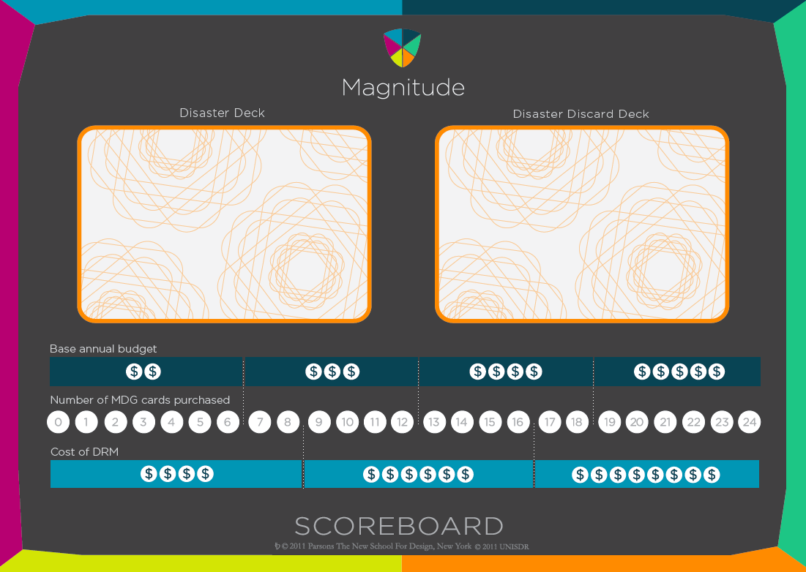
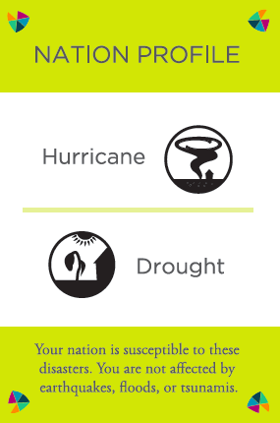


Board Setup
Notes:
Place the big game board and smaller scoreboard where all members of the nation can see.
Nation Profile Card
Some nations are better protected against certain disasters and not against others.
This card states to which natural hazards your nation is most susceptible. Each nation gets a different Nation Profile card and places it in the middle of the game board)
Minister Cards
Each player receives on of the minister MDG priority cards. These can be chosen or randomly drawn by players. A player can look at his card and see his two MDG priorities on one side and the Budget Calculator on the back.

Slide 12
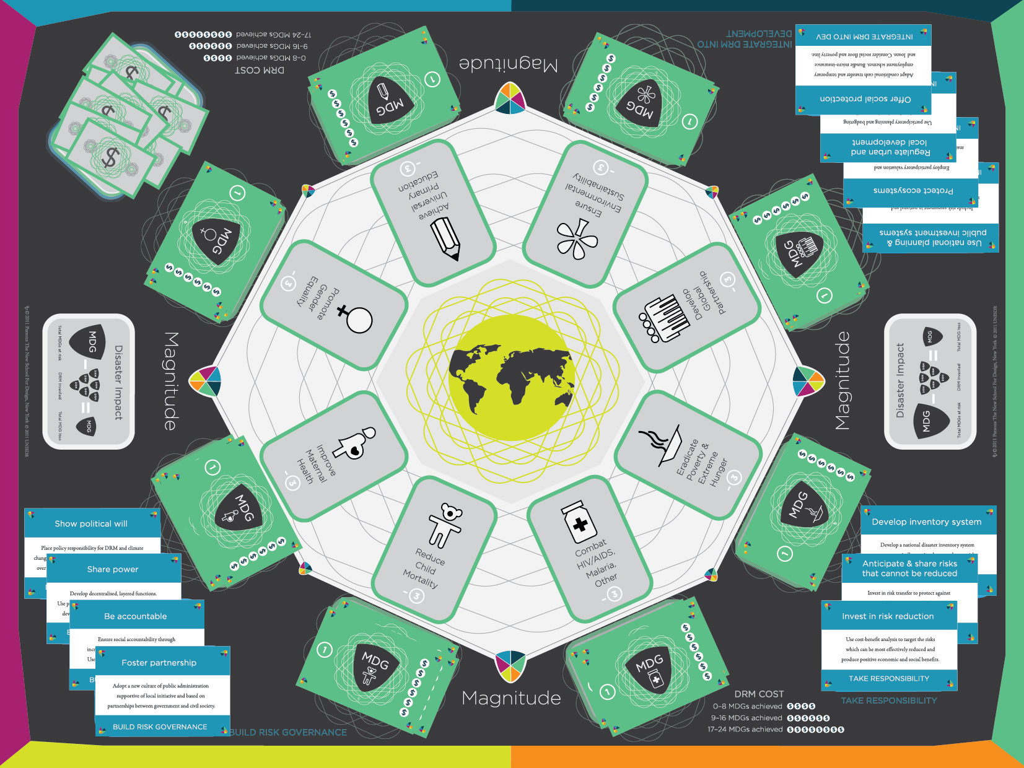
Initial Setup
Notes:
The game board should look like this.

Slide 13
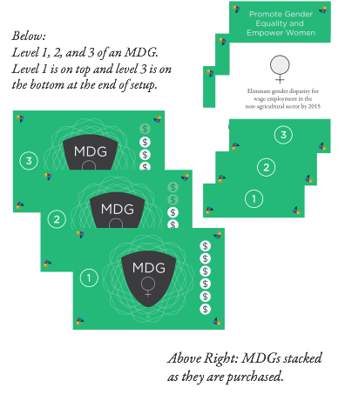
Millennium Development Goals (MDG)
Reduce Child Mortality
Improve Maternal Health
Eradicate Extreme Poverty and Hunger
Combat HIV/AIDS, Malaria, and Other Diseases
Achieve Universal Primary Education
Promote Gender Equality and Empower Women
Ensure Environmental Stability
Develop a Global Partnership for Development
Notes:
There are 8 MDGs and 4 ministers per nation. Therefore, check your Minister card to find out which 2 you that you
For each of the 8 MDGs, find its Level 1, 2, and 3 cards, and stack the 3 cards face down with Level 1 on top and Level 3 on the bottom. Place these cards on the main game board in the horizontal box under the matching MDG icon.
Any minister can buy any MDG (they are not limited to buying the ones on their Minister Profile card.)
The price to purchase MDGs is on the right side of each card (Level 1 costs 6, Level 2 costs 4, Level 3 costs 5).
You must purchase L1 before L2 and L2 before L3.
When you purchase an MDG card you flip it over and place it inside the octagon in its corresponding MDG space.

Slide 14
Millennium Development Goals
Cost of MDGs is based on the level you are purchasing:
Level 1 costs $6
Level 2 costs $4
Level 3 costs $5
Points awarded for MDGs is below:
MDG Achieved @ Level 3 = 6 points
MDG Achieved @ Level 2 = 3 points
MDG Achieved @ Level 1 = 1 points
Notes:
The 8 United Nations Millennium Development Goals (MDGs) are:
Eradicate Extreme Poverty and Hunger
Achieve Universal Primary Education
Promote Gender Equality and Empower Women
Reduce Child Mortality
Improve Maternal Health
Combat HIV/AIDS, Malaria, and Other Diseases
Ensure Environmental Stability
Develop a Global Partnership for Development
MDG cards
For each of the 8 MDGs, find its Level 1, 2, and 3 cards, and stack the 3 cards face down with Level 1 on top and Level 3 on the bottom. Place these cards on the main game board in the horizontal box under the matching MDG icon.
Any minister can buy any MDG (they are not limited to buying the ones on their Minister Profile card.)
The price to purchase MDGs is on the right side of each card (Level 1 costs 6, Level 2 costs 4, Level 3 costs 5).
You must purchase L1 before L2 and L2 before L3.
When you purchase an MDG card you flip it over and place it inside the octagon in its corresponding MDG space.

Slide 15
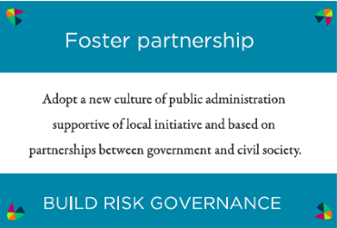

Disaster Risk Management (DRM) Cards
The price of DRM cards is based on your current level of achieved MDGs (either $4, $6, or $8).
Notes:
Disaster Risk Management
Place each DRM card face up on the board in the DRM box which matches the card’s category name. A card’s DRM category name is at the bottom of each Disaster Risk Management (DRM).
The three DRM categories are:
Take Responsibility (3 cards)
Integrate DRM into Development (4 cards)
Build Risk Governance (4 cards)
The price to buy a unit of DRM depends on the number of “achieved MDGs” at the beginning of each year. (See next slide on “Scoreboard”.)
When a minister buys a unit of DRM they can place it in front of them. (Note to facilitator: This helps later in the game to acknowledge which ministers invested in particular DRM.)

Slide 16
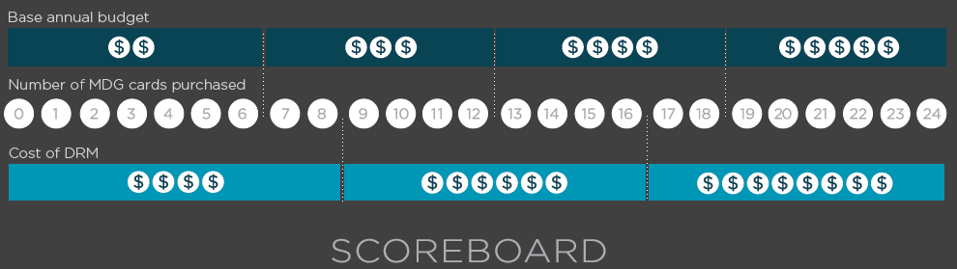
MDG marker
Scoreboard
Notes:
Note to facilitator: For this version of game, each nation should have 1 Scoreboard (use one marked “Regular”). FYI Disaster Deck is simulated in this presentation to ensure that all nations see the same disaster card for each year so there is no need for the orange disaster deck boxes (on the 8.5x11 or A4 size scoreboard only).
Use the provided MDG marker to keep track and update how many achieved MDG cards you have (1) at the start of each year and (2) after minister investments.
Base annual budgets and the cost of DRM are based on the number of achieved MDGs a nation has at the start of each year so nations should use this part of the scoreboard to determine how much to collect or pay respectively.

Slide 17
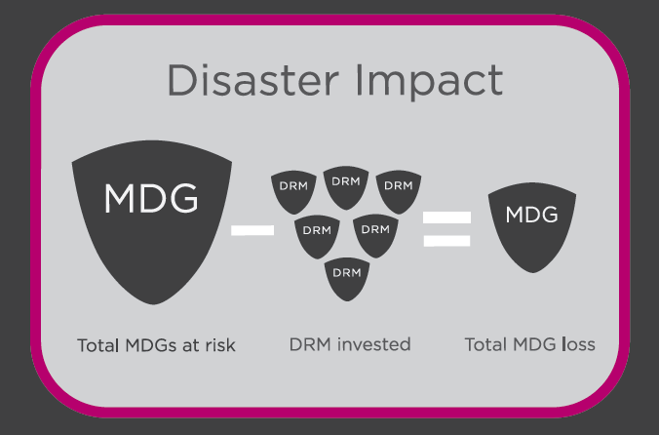
Why DRM cards?
Notes:
So each nation is susceptible to 2 natural hazards depending on their assigned nation profile. At the end of each round, we find out what type of disaster struck that year, and if it’s a disaster that you’re susceptible to, then you might lose some of your MDG progress. How many is determined by how many MDG cards you have achieved as well as the number of DRM you have invested. For this equation, the “Total MDGs at risk” will appear on the revealed disaster card for each year/round (based on the total number of MDGs you have achieved). Take this number and subtract the number of DRM you’ve invested in and you’ll get the “Total MDG loss” or how many MDG cards you must removed from the achieved area and move to the unachieved area. Note: if you have more DRM than “Total MDGs at risk” then you lose nothing.

Slide 18
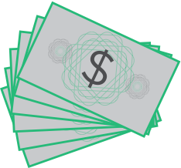
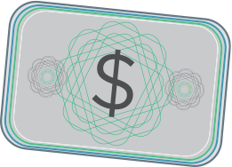
Annual Budget
The Bank
OR
Each player starts
the game w/ 6 units
Notes:
Annual Budget
All ministers receive 6 money units as their first year budget. Budgets will vary each subsequent year. See “Collect Annual Ministry Budget” under “How to Play” to learn more about future annual budgets.
The Bank
Stack the money pieces in the designated “Bank $” area on the board. When making investments players put the spent money back in the Bank.

Slide 19
Each Round (year)
Count “Achieved MDGs” and place MDG Marker on corresponding number
Collect Annual Budget
Make Ministry Investments or Fundraise
Buy MDG or DRM cards
if you buy nothing, you can collect $1 because you spent your turn fundraising
Count “Achieved MDGs” and place MDG Marker on corresponding number
Determine Disaster / Effect
Notes:
The game starts in 2006 and each round represents a calendar year. There are 10 rounds ending with the year 2015. The game is over the round after the last disaster slide is revealed.
These are the phases that should be completed in this order for each round (also called year)
NOTE: Players can buy more than 1 item on their turn but they cannot share money between each other.
For additional explanation, please refer to Magnitude Game Rule Set document.

Slide 20
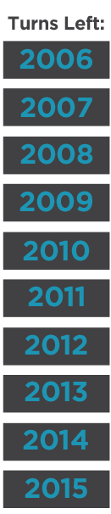


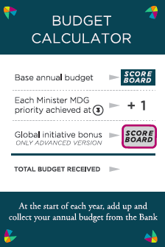
2006
Place MDG Marker on 0
Collect Base Annual Budget
Make Ministry Investments or Fundraise ($1)
Update MDG Marker
Notes:
First round, players start with 6 (don’t collect additional annual budget). NOTE: Players can buy more than 1 item on their turn but they cannot share money between each other.
INVESTING IN MDG
Any minister can buy any MDG (they are not limited to buying the ones on their Minister Profile card.)
The price to purchase MDGs is on the right side of each card (Level 1 costs 6, Level 2 costs 4, Level 3 costs 5).
You must purchase L1 before L2 and L2 before L3.
When you purchase an MDG card you flip it over and place it inside the octagon in its corresponding MDG space. This means it is now achieved.
INVESTING IN DRM
The price to buy a unit of DRM depends on the number of “achieved MDGs” at the beginning of each year. (Use “MDG Marker” on Scoreboard to determine the price.)
When a minister buys a unit of DRM they can place it in front of them. (Note to facilitator: This helps later in the game to acknowledge which ministers invested in particular DRM.)

Slide 21

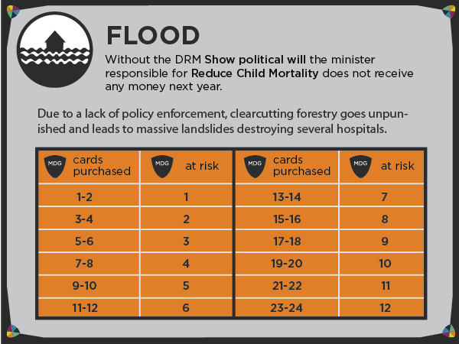
Notes:
Facilitator reads the text out loud to the group.
Nations check their nation profile card. If they have an icon matching this disaster on their nation card then they are affected by this disaster slide. (If they do not have a matching icon, then they are not affected at all.)
Affected nations without the specified DRM (mentioned just below the disaster type) lose 1 achieved MDG. They must take one MDG card from the center octagon, flip it, and put it back where it started.
Affected nations should now find the number of MDGs they currently have achieved in the “MDG cards purchased” column. Then they should look to the right of that column and find the corresponding number of “MDGs at risk.”
Take this “MDGs at risk” number and subtract any purchased DRM. If this is a positive number, the nation must move this many achieved MDG cards from the center octagon, flip them over, and put back where each card started.
Example: If a nation has purchased 1 DRM card and currently has 4 achieved MDGs (cards inside octagon) so far in the game and it is not “Show political will”, then the nation must remove 1 MDG from the center octagon and return to it’s original position.

Slide 22
Annual Budget
Notes:
After the first year, each player should use their Budget Calculator to determine how much money they receive at the beginning of each year.
Base Annual Budget – is based on number of MDGs achieved as marked on “Scoreboard”
Minister MDG Priorities – each minister has 2 MDG priorities (marked on back of Budget Calculator). For each of these which is achieved to Level 3, that minister receives $1 bonus
Global Initiative bonus – There are none for this version of the game.

Slide 23
2007
Update MDG Marker
Collect Annual Budget
Make Ministry Investments or Fundraise ($1)
Update MDG Marker
Notes:
NOTE: Players can buy more than 1 item on their turn but they cannot share money between each other.
INVESTING IN MDG
Any minister can buy any MDG (they are not limited to buying the ones on their Minister Profile card.)
The price to purchase MDGs is on the right side of each card (Level 1 costs 6, Level 2 costs 4, Level 3 costs 5).
You must purchase L1 before L2 and L2 before L3.
When you purchase an MDG card you flip it over and place it inside the octagon in its corresponding MDG space. This means it is now achieved.
INVESTING IN DRM
The price to buy a unit of DRM depends on the number of “achieved MDGs” at the beginning of each year. (Use “MDG Marker” on Scoreboard to determine the price.)
When a minister buys a unit of DRM they can place it in front of them. (Note to facilitator: This helps later in the game to acknowledge which ministers invested in particular DRM.)

Slide 24

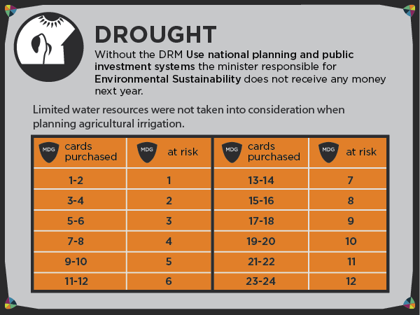
Notes:
Nations check their nation profile card. If they have an icon matching this disaster on their nation card then they are affected by this disaster slide. (If they do not have a matching icon, then they are not affected at all.)
Facilitator reads the text out loud to the group.
Affected nations without the specified DRM (mentioned just below the disaster type) lose 1 achieved MDG. They must take one MDG card from the center octagon, flip it, and put it back where it started.
Affected nations should now find the number of MDGs they currently have achieved in the “MDG cards purchased” column. Then they should look to the right of that column and find the corresponding number of “MDGs at risk.”
Take this number and subtract any purchased DRM. If this is a positive number, the nation must move this many achieved MDG cards from the center octagon, flip over, and put back where each card started.
Example: If a nation has purchased 1 DRM card so far in the game and it is not “Show political will”, then the nation must remove 1 MDG from the center octagon and return to it’s original position.

Slide 25
2008
Update MDG Marker
Collect Annual Budget
Make Ministry Investments or Fundraise ($1)
Update MDG Marker
Notes:
NOTE: Players can buy more than 1 item on their turn but they cannot share money between each other.
INVESTING IN MDG
Any minister can buy any MDG (they are not limited to buying the ones on their Minister Profile card.)
The price to purchase MDGs is on the right side of each card (Level 1 costs 6, Level 2 costs 4, Level 3 costs 5).
You must purchase L1 before L2 and L2 before L3.
When you purchase an MDG card you flip it over and place it inside the octagon in its corresponding MDG space. This means it is now achieved.
INVESTING IN DRM
The price to buy a unit of DRM depends on the number of “achieved MDGs” at the beginning of each year. (Use “MDG Marker” on Scoreboard to determine the price.)
When a minister buys a unit of DRM they can place it in front of them. (Note to facilitator: This helps later in the game to acknowledge which ministers invested in particular DRM.)

Slide 26

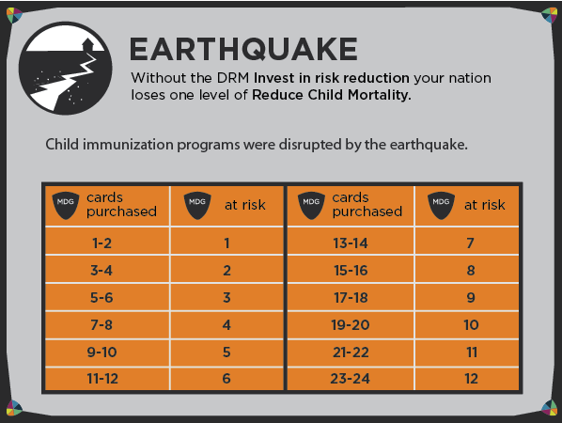
Notes:
Nations check their nation profile card. If they have an icon matching this disaster on their nation card then they are affected by this disaster slide. (If they do not have a matching icon, then they are not affected at all.)
Facilitator reads the text out loud to the group.
Affected nations without the specified DRM (mentioned just below the disaster type) lose 1 achieved MDG. They must take one MDG card from the center octagon, flip it, and put it back where it started.
Affected nations should now find the number of MDGs they currently have achieved in the “MDG cards purchased” column. Then they should look to the right of that column and find the corresponding number of “MDGs at risk.”
Take this number and subtract any purchased DRM. If this is a positive number, the nation must move this many achieved MDG cards from the center octagon, flip over, and put back where each card started.
Example: If a nation has purchased 1 DRM card so far in the game and it is not “Show political will”, then the nation must remove 1 MDG from the center octagon and return to it’s original position.

Slide 27
2009
Update MDG Marker
Collect Annual Budget
Make Ministry Investments or Fundraise ($1)
Update MDG Marker
Notes:
NOTE: Players can buy more than 1 item on their turn but they cannot share money between each other.
INVESTING IN MDG
Any minister can buy any MDG (they are not limited to buying the ones on their Minister Profile card.)
The price to purchase MDGs is on the right side of each card (Level 1 costs 6, Level 2 costs 4, Level 3 costs 5).
You must purchase L1 before L2 and L2 before L3.
When you purchase an MDG card you flip it over and place it inside the octagon in its corresponding MDG space. This means it is now achieved.
INVESTING IN DRM
The price to buy a unit of DRM depends on the number of “achieved MDGs” at the beginning of each year. (Use “MDG Marker” on Scoreboard to determine the price.)
When a minister buys a unit of DRM they can place it in front of them. (Note to facilitator: This helps later in the game to acknowledge which ministers invested in particular DRM.)

Slide 28
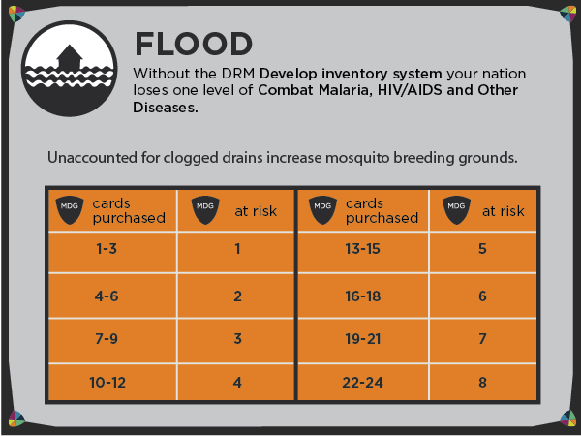
Notes:
Nations check their nation profile card. If they have an icon matching this disaster on their nation card then they are affected by this disaster slide. (If they do not have a matching icon, then they are not affected at all.)
Facilitator reads the text out loud to the group.
Affected nations without the specified DRM (mentioned just below the disaster type) lose 1 achieved MDG. They must take one MDG card from the center octagon, flip it, and put it back where it started.
Affected nations should now find the number of MDGs they currently have achieved in the “MDG cards purchased” column. Then they should look to the right of that column and find the corresponding number of “MDGs at risk.”
Take this number and subtract any purchased DRM. If this is a positive number, the nation must move this many achieved MDG cards from the center octagon, flip over, and put back where each card started.
Example: If a nation has purchased 1 DRM card so far in the game and it is not “Show political will”, then the nation must remove 1 MDG from the center octagon and return to it’s original position.

Slide 29
2010
Update MDG Marker
Collect Annual Budget
Make Ministry Investments or Fundraise ($1)
Update MDG Marker
Notes:
NOTE: Players can buy more than 1 item on their turn but they cannot share money between each other.
INVESTING IN MDG
Any minister can buy any MDG (they are not limited to buying the ones on their Minister Profile card.)
The price to purchase MDGs is on the right side of each card (Level 1 costs 6, Level 2 costs 4, Level 3 costs 5).
You must purchase L1 before L2 and L2 before L3.
When you purchase an MDG card you flip it over and place it inside the octagon in its corresponding MDG space. This means it is now achieved.
INVESTING IN DRM
The price to buy a unit of DRM depends on the number of “achieved MDGs” at the beginning of each year. (Use “MDG Marker” on Scoreboard to determine the price.)
When a minister buys a unit of DRM they can place it in front of them. (Note to facilitator: This helps later in the game to acknowledge which ministers invested in particular DRM.)

Slide 30

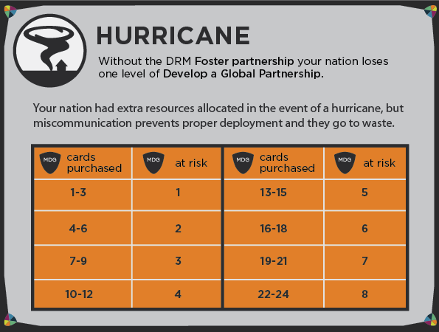

Slide 31
2011
Update MDG Marker
Collect Annual Budget
Make Ministry Investments or Fundraise ($1)
Update MDG Marker
Notes:
NOTE: Players can buy more than 1 item on their turn but they cannot share money between each other.
INVESTING IN MDG
Any minister can buy any MDG (they are not limited to buying the ones on their Minister Profile card.)
The price to purchase MDGs is on the right side of each card (Level 1 costs 6, Level 2 costs 4, Level 3 costs 5).
You must purchase L1 before L2 and L2 before L3.
When you purchase an MDG card you flip it over and place it inside the octagon in its corresponding MDG space. This means it is now achieved.
INVESTING IN DRM
The price to buy a unit of DRM depends on the number of “achieved MDGs” at the beginning of each year. (Use “MDG Marker” on Scoreboard to determine the price.)
When a minister buys a unit of DRM they can place it in front of them. (Note to facilitator: This helps later in the game to acknowledge which ministers invested in particular DRM.)

Slide 32

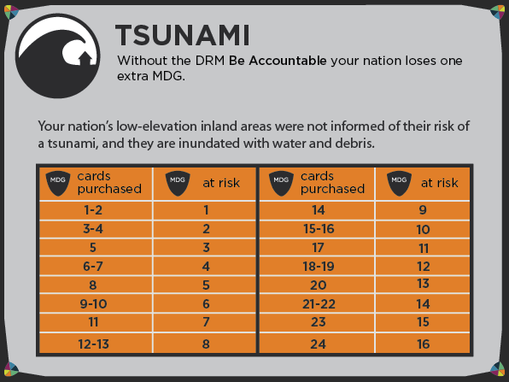
Notes:
Nations check their nation profile card. If they have an icon matching this disaster on their nation card then they are affected by this disaster slide. (If they do not have a matching icon, then they are not affected at all.)
Facilitator reads the text out loud to the group.
Affected nations without the specified DRM (mentioned just below the disaster type) lose 1 achieved MDG. They must take one MDG card from the center octagon, flip it, and put it back where it started.
Affected nations should now find the number of MDGs they currently have achieved in the “MDG cards purchased” column. Then they should look to the right of that column and find the corresponding number of “MDGs at risk.”
Take this number and subtract any purchased DRM. If this is a positive number, the nation must move this many achieved MDG cards from the center octagon, flip over, and put back where each card started.
Example: If a nation has purchased 1 DRM card so far in the game and it is not “Show political will”, then the nation must remove 1 MDG from the center octagon and return to it’s original position.

Slide 33
2012
Update MDG Marker
Collect Annual Budget
Make Ministry Investments or Fundraise ($1)
Update MDG Marker
Notes:
NOTE: Players can buy more than 1 item on their turn but they cannot share money between each other.
INVESTING IN MDG
Any minister can buy any MDG (they are not limited to buying the ones on their Minister Profile card.)
The price to purchase MDGs is on the right side of each card (Level 1 costs 6, Level 2 costs 4, Level 3 costs 5).
You must purchase L1 before L2 and L2 before L3.
When you purchase an MDG card you flip it over and place it inside the octagon in its corresponding MDG space. This means it is now achieved.
INVESTING IN DRM
The price to buy a unit of DRM depends on the number of “achieved MDGs” at the beginning of each year. (Use “MDG Marker” on Scoreboard to determine the price.)
When a minister buys a unit of DRM they can place it in front of them. (Note to facilitator: This helps later in the game to acknowledge which ministers invested in particular DRM.)

Slide 34
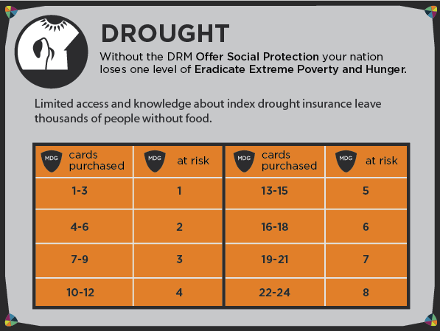
Notes:
Nations check their nation profile card. If they have an icon matching this disaster on their nation card then they are affected by this disaster slide. (If they do not have a matching icon, then they are not affected at all.)
Facilitator reads the text out loud to the group.
Affected nations without the specified DRM (mentioned just below the disaster type) lose 1 achieved MDG. They must take one MDG card from the center octagon, flip it, and put it back where it started.
Affected nations should now find the number of MDGs they currently have achieved in the “MDG cards purchased” column. Then they should look to the right of that column and find the corresponding number of “MDGs at risk.”
Take this number and subtract any purchased DRM. If this is a positive number, the nation must move this many achieved MDG cards from the center octagon, flip over, and put back where each card started.
Example: If a nation has purchased 1 DRM card so far in the game and it is not “Show political will”, then the nation must remove 1 MDG from the center octagon and return to it’s original position.

Slide 35
2013
Update MDG Marker
Collect Annual Budget
Make Ministry Investments or Fundraise ($1)
Update MDG Marker
Notes:
NOTE: Players can buy more than 1 item on their turn but they cannot share money between each other.
INVESTING IN MDG
Any minister can buy any MDG (they are not limited to buying the ones on their Minister Profile card.)
The price to purchase MDGs is on the right side of each card (Level 1 costs 6, Level 2 costs 4, Level 3 costs 5).
You must purchase L1 before L2 and L2 before L3.
When you purchase an MDG card you flip it over and place it inside the octagon in its corresponding MDG space. This means it is now achieved.
INVESTING IN DRM
The price to buy a unit of DRM depends on the number of “achieved MDGs” at the beginning of each year. (Use “MDG Marker” on Scoreboard to determine the price.)
When a minister buys a unit of DRM they can place it in front of them. (Note to facilitator: This helps later in the game to acknowledge which ministers invested in particular DRM.)

Slide 36
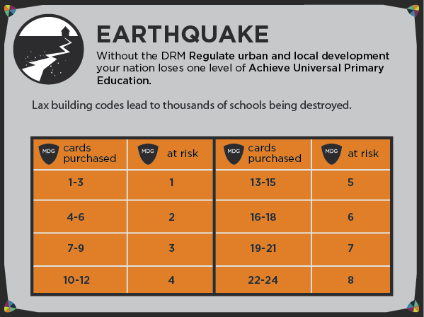
Notes:
Nations check their nation profile card. If they have an icon matching this disaster on their nation card then they are affected by this disaster slide. (If they do not have a matching icon, then they are not affected at all.)
Facilitator reads the text out loud to the group.
Affected nations without the specified DRM (mentioned just below the disaster type) lose 1 achieved MDG. They must take one MDG card from the center octagon, flip it, and put it back where it started.
Affected nations should now find the number of MDGs they currently have achieved in the “MDG cards purchased” column. Then they should look to the right of that column and find the corresponding number of “MDGs at risk.”
Take this number and subtract any purchased DRM. If this is a positive number, the nation must move this many achieved MDG cards from the center octagon, flip over, and put back where each card started.
Example: If a nation has purchased 1 DRM card so far in the game and it is not “Show political will”, then the nation must remove 1 MDG from the center octagon and return to it’s original position.

Slide 37
2014
Update MDG Marker
Collect Annual Budget
Make Ministry Investments or Fundraise ($1)
Update MDG Marker
Notes:
NOTE: Players can buy more than 1 item on their turn but they cannot share money between each other.
INVESTING IN MDG
Any minister can buy any MDG (they are not limited to buying the ones on their Minister Profile card.)
The price to purchase MDGs is on the right side of each card (Level 1 costs 6, Level 2 costs 4, Level 3 costs 5).
You must purchase L1 before L2 and L2 before L3.
When you purchase an MDG card you flip it over and place it inside the octagon in its corresponding MDG space. This means it is now achieved.
INVESTING IN DRM
The price to buy a unit of DRM depends on the number of “achieved MDGs” at the beginning of each year. (Use “MDG Marker” on Scoreboard to determine the price.)
When a minister buys a unit of DRM they can place it in front of them. (Note to facilitator: This helps later in the game to acknowledge which ministers invested in particular DRM.)

Slide 38
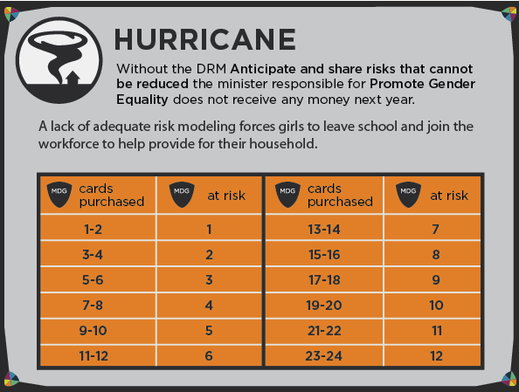
Notes:
Nations check their nation profile card. If they have an icon matching this disaster on their nation card then they are affected by this disaster slide. (If they do not have a matching icon, then they are not affected at all.)
Facilitator reads the text out loud to the group.
Affected nations without the specified DRM (mentioned just below the disaster type) lose 1 achieved MDG. They must take one MDG card from the center octagon, flip it, and put it back where it started.
Affected nations should now find the number of MDGs they currently have achieved in the “MDG cards purchased” column. Then they should look to the right of that column and find the corresponding number of “MDGs at risk.”
Take this number and subtract any purchased DRM. If this is a positive number, the nation must move this many achieved MDG cards from the center octagon, flip over, and put back where each card started.
Example: If a nation has purchased 1 DRM card so far in the game and it is not “Show political will”, then the nation must remove 1 MDG from the center octagon and return to it’s original position.

Slide 39
2015
Update MDG Marker
Collect Annual Budget
Make Ministry Investments or Fundraise ($1)
Update MDG Marker
Notes:
NOTE: Players can buy more than 1 item on their turn but they cannot share money between each other.
INVESTING IN MDG
Any minister can buy any MDG (they are not limited to buying the ones on their Minister Profile card.)
The price to purchase MDGs is on the right side of each card (Level 1 costs 6, Level 2 costs 4, Level 3 costs 5).
You must purchase L1 before L2 and L2 before L3.
When you purchase an MDG card you flip it over and place it inside the octagon in its corresponding MDG space. This means it is now achieved.
INVESTING IN DRM
The price to buy a unit of DRM depends on the number of “achieved MDGs” at the beginning of each year. (Use “MDG Marker” on Scoreboard to determine the price.)
When a minister buys a unit of DRM they can place it in front of them. (Note to facilitator: This helps later in the game to acknowledge which ministers invested in particular DRM.)

Slide 40
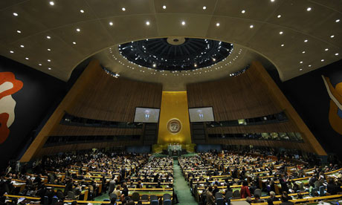
Count up your points, and see how your nation stacks up against the rest. MDG @ Level 3 = 6 points MDG @ Level 2 = 3 points MDG @ Level 1 = 1 points Unachieved MDG = - 3 points A completed board adds up to a total of 48 points.
How advanced is your nation?

Slide 41
0-16 points | Despite your efforts, there were just too many disastrous setbacks for your nation to make any real progress on the Millennium Development Goals. The four of you should have worked together as a team of ministers and considered measures to protect and make your nation more resilient if you cared about staying in office. You’ve been impeached for improper and incompetent governance. Spread the word about disaster risk management so your replacements don’t make the same mistake.
17-24 points | Many of the Millennium Development Goals have not been achieved because the necessary programs are extremely behind. The incoming president decides to take away your budget and give it to more responsible and able ministers. This unfortunately means you'll have to find a new job. Better luck next time!
25-32 points | While you have made some steady progress on all the Millennium Development Goals, your nation has fully achieved very few of them. You may not have made the 2015 deadline to achieve all 8 Millennium Development Goals, but if you increase your efforts and work on disaster risk management projects, you should be able to fully achieve all the Millennium Development Goals by 2020. The government review board is still weary of your abilities to perform your ministry duties so you may have to defend your decisions and your job in light of your nation’s Millennium Development Goals shortcomings.
33-39 points | You have proven that teamwork and long-term investments in disaster risk management can make a difference. Your nation is more financially sound, healthier, better educated, and living longer lives, but there is still a little more work to be done. The president reappoints all 4 of you and tasks you to fully achieve the remaining Millennium Development Goals by 2018. Good luck!
40-48 points | All the other U.N. nations give your nation kudos for exemplary teamwork and prioritization towards fully achieving so many of the Millennium Development Goals by the 2015 deadline. You are invited to speak at U.N. conferences about your success story. Be sure to share with others the importance of investing in disaster risk management in your nation’s overall development plan. You are all reappointed for another term, and your political future look bright! Keep up the good work!

Slide 42
Game Debrief
Share the types of discussion your team/nation members engaged in throughout the game.
What was the role of Disaster Risk Management in the game? How did it help or distract from making progress towards the main criteria for success (i.e. development)?
In this game, players are told that the 8 Millennium Development Goals (MDGs) identified by the UN are the most valued measures of progress. What do you personally identify as important measures for progress? How about in your community?
Based on your experience playing a national minister in this game: what measures would you want your government to take? What recommendations would you have for them?
Notes:
These are just some guiding questions. Facilitators can modify this to come up with their own form of debrief.
Players should make the connection that while they would want their govt to invest in the advancement or development of their country, they would want them to be cautious and take into account how they could protect their investments. In this game it focuses on the potential risk and loss from natural hazards, but it can include other types of hazards or crises.
The game is also designed to create some tension and tradeoffs between just investing in development or just in preparedness. If you only focus on development, you risk losing a lot of your investments and not being able to bounce back. If you focus only on preparedness, you have no development (partly because you have no increase in income/budget), which is the actual measure for national success in this game.

Slide 43


Slide 44
DRM // Take Responsibility
Invest in risk reduction: Use cost-benefit analysis to target the risks which can be most effectively reduced and produce positive economic and social benefits.
Anticipate & share risks that cannot be reduced: Invest in risk transfer to protect against catastrophic loss. Anticipate and prepare for emerging risks
Develop inventory system: Develop a national disaster inventory system to systemically monitor losses and assess risks at all scales using probabilistic models.

Slide 45
DRM // Integrate DRM into Development
Protect ecosystems: Employ participatory valuation and management of ecosystem services and mainstreaming of ecosystem approaches in DRM.
Regulate urban and local development: Use participatory planning and budgeting to upgrade informal settlements, allocate land and promote safe building.
Use national planning & public investment systems: Include risk assessment in national and sector development planning and investment.
Offer social protection: Adapt conditional cash transfer and temporary employment schemes. Bundle micro-insurance and loans. Consider social floor and poverty line.

Slide 46
DRM // Build Risk Governance
Foster partnership: Adopt a new culture of public administration supportive of local initiative and based on partnerships between government and civil society.
Share power: Develop decentralized, layered functions. Use principles of subsidiarity and appropriate levels of devolution including budgets and to civil society.
Show political will: Place policy responsibility for DRM and climate change adaptation in a ministry with political authority over national development planning and investment.
Be accountable: Ensure social accountability through increased public information and transparency. Use performance-based budgeting and rewards.

